Slide 1
Forecasting with VAR and Anomaly Detection via Machine Learning --Anand Agrawal

Slide 2
1. Objective: To develop a continuously updating, multivariate time series analytics system for proactive server resource monitoring, forecasting, and anomaly detection. The system will initially leverage Vector Autoregression (VAR) to model and forecast correlated server metrics, and will integrate Isolation Forest or Random Cut Forest for robust unsupervised anomaly detection. Future extensions will explore deep learning models like LSTM for sequential pattern learning and improved forecasting accuracy.

Slide 3
2. Data Source: Exclusively using Azure Monitor Logs for capturing time-series server metrics such as CPU usage, memory, disk I/O, and log I/O. Currently focused on monitoring Microsoft SQL Server, with a framework designed for future expansion to other databases and systems.

Slide 4
3. Technology Stack
Languages/Tools: Python, Docker, Kubernetes
Frameworks/Libraries:
stats models → VAR modeling
scikit-learn, PyOD → Isolation Forest / RCF
pandas, NumPy, matplotlib → Data processing + visualization
Azure SDK → Log access
pickle → Model serialization

Slide 5
4. Architecture Overview Azure Monitor Log → Data Ingestion Pipeline Preprocessing → Time Series Modelling (VAR) Anomaly Detection (ML) → Alert Generation Visualization + Logging

Slide 6
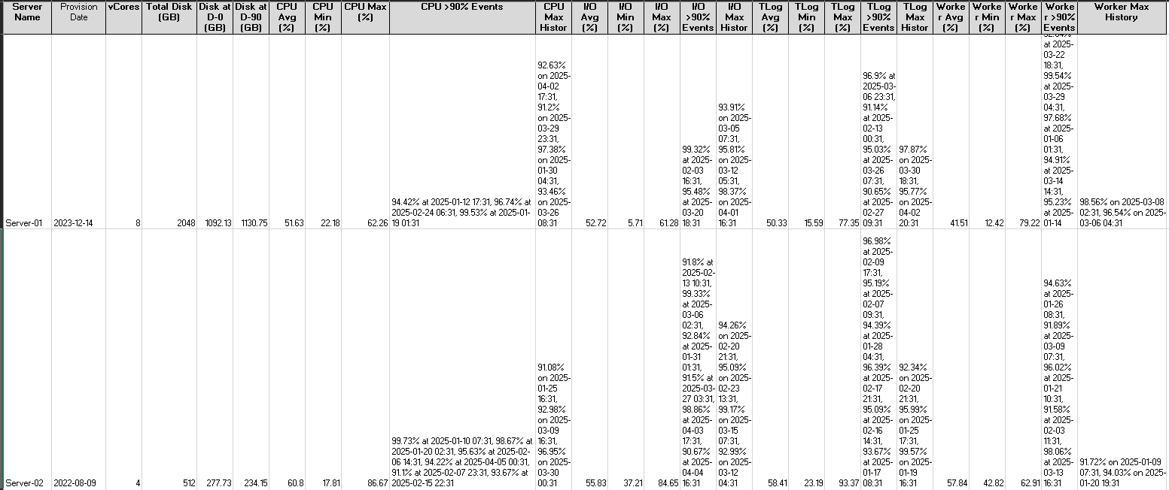
5. Data Overview Source: Azure Monitor Logs Metrics: CPU %, Memory %, Disk I/O, Log I/O, Query Wait Time, etc. Frequency: 1-minute / 5-minute intervals Current Focus: MS SQL Server Metrics

Slide 7
6. VAR Modeling & Forecasting What is VAR? Multivariate statistical model that captures relationships between multiple time series. Use Case: Predict future CPU, Disk usage based on past trends and interdependencies. Forecasting Output: Example: An anomaly is likely to occur on Saturday at 4:00 PM due to historically observed CPU spikes during this time window. In previous instances, these CPU spikes were accompanied by a significant increase in Log I/O, indicating a surge in DML operations on the database. A proactive alert has been triggered for potential threshold breach Disk usage is projected to reach 98% by 12 AM on Sunday, due to the lack of data purging over an extended period. Additionally, Sundays typically see a significant volume of data inserts.

Slide 8
7. Anomaly Detection (Isolation Forest / RCF) Why ML? To capture rare, nonlinear, or seasonal spikes beyond VAR’s capability. Models Used: Isolation Forest (good for high-dimensional, unlabeled data) Random Cut Forest (suitable for streaming or large data) Use Cases: Sudden CPU surge without load Log I/O spike during off-peak hours Long-running queries not seen before

Slide 9
8. Model Validation VAR Model Validation: Train/Test Split (e.g., 80/20) Metrics: MAE (Mean Absolute Error) RMSE (Root Mean Squared Error) Plot actual vs. forecast Anomaly Detection Validation: Manual verification of known anomalies Future: use labeled anomaly datasets Metrics: Precision, Recall, F1 (if labels available)

Slide 10
9. Future Enhancements Extend support to: Other databases: PostgreSQL, MySQL, Oracle, Etc. Cross-platform monitoring: Web servers, Application logs Integrate LSTM for long-term dependencies and seasonality Dashboard-based alerts (Grafana/Power BI) Auto-healing triggers on Kubernetes (restart pod, scale up)

Slide 11
10. Summary Proactively predicts server resource usage Detects anomalies using time series and ML Fully containerized and cloud-integrated Adaptable to other systems beyond MS SQL Server

